Slide 1
Design and Analysis of Algorithms
UNIT 1

Slide 2
Notion of algorithm
problem
algorithm
“computer”
input
output
Algorithmic solution
Notes:
‹#›

Slide 3
UNIT-I
Introduction

Slide 4
Algorithm
An Algorithm is a sequence of unambiguous instructions for solving a problem,
i.e., for obtaining a required output for any legitimate input in a finite amount of time.
Notes:
‹#›

Slide 5
Formatting and Conventions in Pseudocoding
INDENTATION in pseudocode should be identical to its implementation in a programming language. Try to indent at least four spaces.
The pseudocode entries are to be cryptic, AND SHOULD NOT BE PROSE. NO SENTENCES.
No flower boxes in pseudocode.
Do not include data declarations in pseudocode.

Slide 6
Euclid’s Algorithm
Problem: Find gcd(m,n), the greatest common divisor of two nonnegative, not both zero integers m and n
Examples: gcd(60,24) = 12, gcd(60,0) = 60, gcd(0,0) = ?
Euclid’s algorithm is based on repeated application of equality
gcd(m,n) = gcd(n, m mod n)
until the second number becomes 0, which makes the problem
trivial.
Example: gcd(60,24) = gcd(24,12) = gcd(12,0) = 12
Notes:
Euclid’s algorithm is good for introducing the notion of an algorithm because it
makes a clear separation from a program that implements the algorithm.
It is also one that is familiar to most students.
Al Khowarizmi (many spellings possible...) – “algorism” (originally) and then
later “algorithm” come from his name.

Slide 7
Other methods for computing gcd(m,n)
Consecutive integer checking algorithm
Step 1 Assign the value of min{m,n} to t
Step 2 Divide m by t. If the remainder is 0, go to Step 3; otherwise, go to Step 4
Step 3 Divide n by t. If the remainder is 0, return t and stop; otherwise, go to Step 4
Step 4 Decrease t by 1 and go to Step 2

Slide 8
Sieve of Eratosthenes
Input: Integer n ≥ 2
Output: List of primes less than or equal to n
for p ← 2 to n do A[p] ← p
for p ← 2 to ⎣n⎦ do
if A[p] ≠ 0 //p hasn’t been previously eliminated from the list j ← p* p
while j ≤ n do
A[j] ← 0 //mark element as eliminated
j ← j + p
Example: 2 3 4 5 6 7 8 9 10 11 12 13 14 15 16 17 18 19 20

Slide 9
Termination of Euclid’s Algorithm
The second number of the pair gets smaller with each iteration and cannot become negative:
Indeed, the new value of n is r = m mod n, which is always smaller than n.
Eventually, r becomes zero, and the algorithms stops.

Slide 10
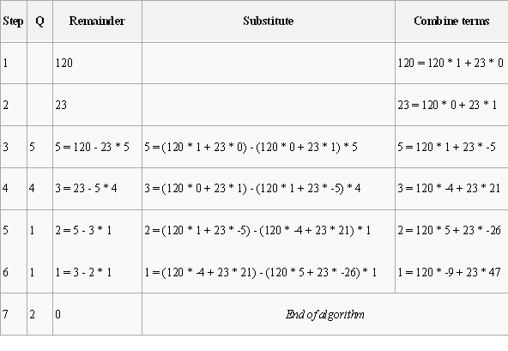
Compute the GCD of 120 and 23.

Slide 11
Fundamentals of Algorithmic Problem Solving
Notes:
‹#›

Slide 12
Fundamentals of Algorithmic Problem Solving
Algorithm = Procedural Solutions to Problem
NOT an answer, BUT rather specific instructions of getting answers.
Therefore, requires steps in designing and analyzing an algorithm
Notes:
‹#›

Slide 13
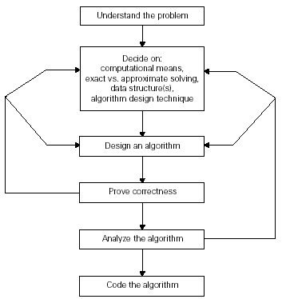
Algorithm Design & Analysis Process

Slide 14
Step 1: Understand the Problem
Before designing an algorithm - understand completely the problem given.
Read the problem’s description carefully and ask questions if you have any doubts about the problem,
Do a few small examples by hand, think about special cases, and ask questions again if needed.

Slide 15
Step 1: Understand the Problem
An input to an algorithm specifies an instance of the problem the algorithm solves.
It is very important to specify exactly the range of instances the algorithm needs to handle.
Failing which – the algorithm works correctly for some inputs , but crashes on some boundary values.
Remember that a correct algorithm is not one that works most of the time but one that works correctly for all legitimate inputs.

Slide 16
Step 2: Ascertaining the capabilities of a computational device
Algorithms designed to be executed on machines that executes intstructions one after another are called sequential algorithms.
Algorithms that take advantage of computers that can execute operations concurrently are called parallel algorithms.

Slide 17
Step 3: Choosing between Exact & Approximate Problem Solving
Solving the problem exactly - Exact algorithms
Solving the problem approximately - Approximation algorithms
Why approximation algorithms?
1. Problems cannot be solved exactly.
Eg. Extracting square roots, solving non-linear equations
2. Available exact algorithms are unacceptably slow because of problem’s complexity
Eg. Traveling Salesman Problem
3. Approx. Algs can be a part of algorithms that solve the problem exactly.

Slide 18
Step 4: Deciding on Appropriate Data Structures
In the new world of object-oriented programming, data structures remain important for both design and analysis of algorithms.
However, we will assume a very basic data structure for now and concentrate on the algorithm side.

Slide 19
Step 5: Algorithm Design Techniques
An algorithm design technique (or “strategy” or “paradigm”) is a general approach to solving problems algorithmically that is applicable to a variety of problems from different areas of computing.
Eg. Brute force, Divide-and-Conquer, Transform-and-Conquer
Importance:
Provide guidance for designing algorithms for new problems.
To classify algorithms according to an underlying design idea.

Slide 20
Step 6: Methods of Specifying an Algorithm
Pseudocode, a mixture of a natural language and programming language-like constructs.
flowchart, a method of expressing an algorithm by a collection of connected geometric shapes containing descriptions of the algorithm’s steps.

Slide 21
Step 7: Proving an Algorithm’s Correctness
Prove algorithm’s correctness = prove that the algorithm yields a required result for every legitimate input in a finite amount of time.
For an approximation algorithm, correctness means to be able to show that the error produced by the algorithm does not exceed a predefined limit.

Slide 22
Step 8: Analyzing an Algorithm
1. Efficiency
Time efficiency indicates how fast the algorithm runs.
space efficiency indicates how much extra memory the algorithm needs.
2. Simplicity
3. Generality
Design an algorithm for a problem posed in more general terms.
Design an algorithm that can handle a range of inputs that is natural for the problem at hand.

Slide 23
Step 9: Coding the algorithm
More than implementation
Peril of incorrect & inefficient implementation
Require testing & debugging
Require code optimizing

Slide 24
Important Problem Types
Notes:
‹#›

Slide 25
Important Problem Types
Sorting
Searching
String processing
Graph problems
Combinatorial problems
Geometric problems
Numerical problems

Slide 26
Sorting
The sorting problem asks us to rearrange the items of a given list in ascending order.
we usually need to
sort lists of numbers,
characters from an alphabet,
character strings,
records similar to those maintained by schools about their students,
libraries about their holdings,
companies about their employees.

Slide 27
Searching
The searching problem deals with finding a given value, called a search key, in a given set (or a multiset, which permits several elements to have the same value).

Slide 28
String Processing
A string is a sequence of characters from an alphabet.
String of particular interest:
1. Text string – comprises letters, numbers, and special characters
2. Bit string – comprises zeros and ones
3. Gene sequence
Mainly string matching problem: searching for a given word in a text

Slide 29
Graph Problems
A graph can be thought of as a collection of points called vertices, some of which are connected by line segments called edges.
Used for modeling a wide variety of real-life applications.
Basic graph algorithms include:
1. Graph traversal algorithms - How can one visit all the points in a network?
2. Shortest-path algorithms - What is the best Introduction route between two cities?
3. Topological sorting for graphs with directed edges

Slide 30
Combinatorial Problems
combinatorial problems: problems that ask (explicitly or implicitly) to find a combinatorial object—such as a permutation, a combination, or a subset—that satisfies certain constraints and has some desired property (e.g., maximizes a value or minimizes a cost).
1. Combinatorial grows extremely fast with problem size
2. No known algorithm solving most such problems exactly in an acceptable amount of time.

Slide 31
Geometric Problems
Geometric algorithms deal with geometric objects such as points, lines, and polygons.
2 class problems:
The closest pair problem: given n points in the plane, find the closest pair among them.
The convex hull problem asks to find the smallest convex polygon that would include all the points of a given set. If

Slide 32

Convex hull problem

Slide 33
Numerical Problems
Numerical problems, another large special area of applications, are problems that involve mathematical objects of continuous nature: solving equations and systems of equations, computing definite integrals, evaluating functions, and so on.

Slide 34
Fundamentals of Analysis of algorithm efficiency

Slide 35
Analysis of algorithms
Issues:
correctness
time efficiency
space efficiency
optimality
Approaches:
theoretical analysis
empirical analysis

Slide 36
Theoretical analysis of time efficiency
Time efficiency is analyzed by determining the number of repetitions of the basic operation as a function of input size
Basic operation: the operation that contributes the most towards the running time of the algorithm
T(n) ≈ c_{op}C(n)
input size
running time
execution time
for basic operation
or cost
Number of times basic operation is executed
Note: Different basic operations may cost differently!

Slide 37
Input size and basic operation examples
Problem | Input size measure | Basic operation
Searching for key in a list of n items | Number of list’s items, i.e. n | Key comparison
Multiplication of two matrices | Matrix dimensions or total number of elements | Multiplication of two numbers
Checking primality of a given integer n | n’size = number of digits (in binary representation) | Division
Typical graph problem | #vertices and/or edges | Visiting a vertex or traversing an edge

Slide 38
Empirical analysis of time efficiency
Select a specific (typical) sample of inputs
Use physical unit of time (e.g., milliseconds)
or
Count actual number of basic operation’s executions
Analyze the empirical data

Slide 39
Efficiencies
Worst Case Efficiency:
Is its efficiency for the worst case input of size n, which is an input of size n for which the algorithm runs the longest among all possible inputs of that size
C_{worst}(n)
Best-case efficiency:
Is its efficiency for the worst case input of size n, which is an input of size n for which the algorithm runs the fastest among all possible inputs of that size
C_{best}(n)

Slide 40
Amortized efficiency
It applies not to a single run of an algorithm, but rather to a sequence of operations performed on the same data structure

Slide 41
Best-case, average-case, worst-case
For some algorithms, efficiency depends on form of input:
Worst case: C_{worst}(n) – maximum over inputs of size n
Best case: C_{best}(n) – minimum over inputs of size n
Average case: C_{avg}(n) – “average” over inputs of size n
Number of times the basic operation will be executed on typical input
NOT the average of worst and best case
Expected number of basic operations considered as a random variable under some assumption about the probability distribution of all possible inputs. So, avg = expected under uniform distribution.

Slide 42
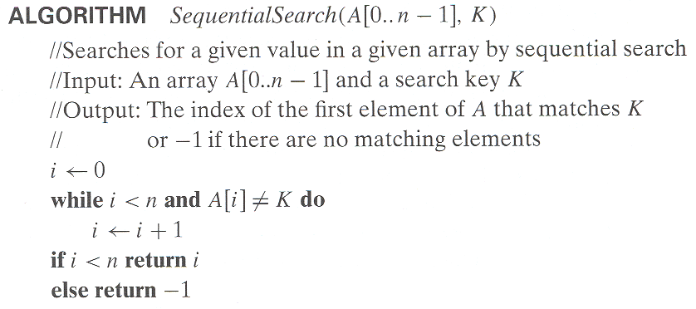
Example: Sequential search
Worst case
Best case
Average case
n key comparisons
1 comparisons
(n+1)/2, assuming K is in A

Slide 43
Types of formulas for basic operation’s count
Exact formula
e.g., C(n) = n(n-1)/2
Formula indicating order of growth with specific multiplicative constant
e.g., C(n) ≈ 0.5 n²
Formula indicating order of growth with unknown multiplicative constant
e.g., C(n) ≈ cn²

Slide 44
Order of growth
Most important: Order of growth within a constant multiple as n→∞
Example:
How much faster will algorithm run on computer that is twice as fast?
How much longer does it take to solve problem of double input size?
Notes:
Example: cn²
how much faster on twice as fast computer? (2)
how much longer for 2n? (4)

Slide 45
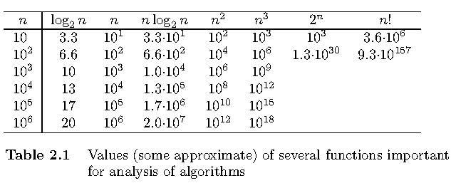
Values of some important functions as n → ∞

Slide 46
Asymptotic Notations
O (Big-Oh)-notation
Ω (Big-Omega) -notation
Θ (Big-Theta) -notation

Slide 47
Asymptotic order of growth
A way of comparing functions that ignores constant factors and small input sizes (because?)
O(g(n)): class of functions f(n) that grow no faster than g(n)
Θ(g(n)): class of functions f(n) that grow at same rate as g(n)
Ω(g(n)): class of functions f(n) that grow at least as fast as g(n)

Slide 48
O-notation
Definition: A function t(n) is said to be in O(g(n)), denoted t(n) ∈ O(g(n)) is bounded above by some constant multiple of g(n) for all large n, i.e., there exist positive constant c and non-negative integer n₀ such that
f(n) ≤ c g(n) for every n ≥ n₀
Notes:
Examples:
10n is O(n²)
since 10n ≤ 10n² for n ≥ 1 or 10n ≤ n² for n ≥ 10
c n₀
5n+20 is O(10n)
since 5n+20 ≤ 10 n for n ≥ 4
c n₀

Slide 49
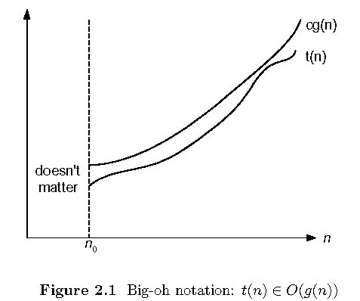
Big-oh

Slide 50
Ω-notation
Formal definition
A function t(n) is said to be in Ω(g(n)), denoted t(n) ∈ Ω(g(n)), if t(n) is bounded below by some constant multiple of g(n) for all large n, i.e., if there exist some positive constant c and some nonnegative integer n₀ such that
t(n) ≥ cg(n) for all n ≥ n₀

Slide 51
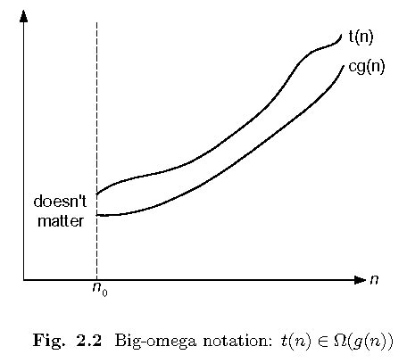
Big-omega

Slide 52
Θ-notation
Formal definition
A function t(n) is said to be in Θ(g(n)), denoted t(n) ∈ Θ(g(n)), if t(n) is bounded both above and below by some positive constant multiples of g(n) for all large n, i.e., if there exist some positive constant c₁ and c₂ and some nonnegative integer n₀ such that
c₂ g(n) ≤ t(n) ≤ c₁ g(n) for all n ≥ n₀

Slide 53
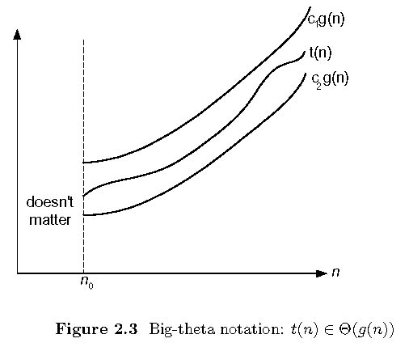
Big-theta

Slide 54
Theorem
If t₁(n) ∈ O(g₁(n)) and t₂(n) ∈ O(g₂(n)), then
t₁(n) + t₂(n) ∈ O(max{g₁(n), g₂(n)}).
The analogous assertions are true for the Ω-notation and Θ-notation.
Proof. There exist constants c1, c2, n1, n2 such that
t1(n) ≤ c1*g1(n), for all n ≥ n1
t2(n) ≤ c2*g2(n), for all n ≥ n2
Define c3 = c1 + c2 and n3 = max{n1,n2}. Then
t1(n) + t2(n) ≤ c3*max{g1(n), g2(n)}, for all n ≥ n3

Slide 55
Some properties of asymptotic order of growth
f(n) ∈ O(f(n))
f(n) ∈ O(g(n)) iff g(n) ∈Ω(f(n))
If f (n) ∈ O(g (n)) and g(n) ∈ O(h(n)) , then f(n) ∈ O(h(n)) Note similarity with a ≤ b
If f₁(n) ∈ O(g₁(n)) and f₂(n) ∈ O(g₂(n)) , then
f₁(n) + f₂(n) ∈ O(max{g₁(n), g₂(n)})
Also, Σ_{1≤i≤n} Θ(f(i)) = Θ (Σ_{1≤i≤n} f(i))

Slide 56
Establishing order of growth using limits
0 order of growth of T(n) < order of growth of g(n)
lim T(n)/g(n) =
c > 0 order of growth of T(n) = order of growth of g(n)
n→∞
∞ order of growth of T(n) > order of growth of g(n)

Slide 57
L’Hôpital’s rule and Stirling’s formula
L’Hôpital’s rule: If lim_{n→∞} f(n) = lim_{n→∞} g(n) = ∞ and
the derivatives f´, g´ exist, then
Stirling’s formula: n! ≈ (2πn)^{1/2} (n/e)^{n}
f(n)
g(n)
f ´(n)
g ´(n)
lim
n→∞
=
lim
n→∞
Example: log n vs. n
Example: 2^{n} vs. n!

Slide 58
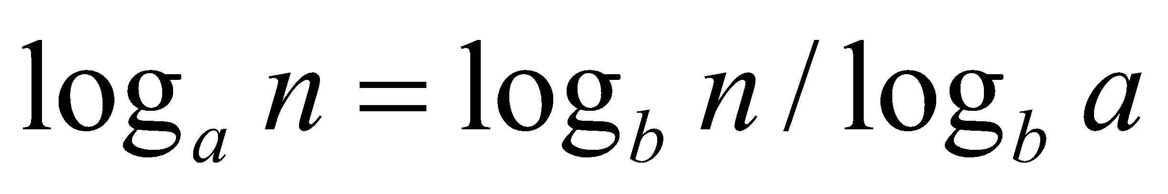
Orders of growth of some important functions
All logarithmic functions log_{a} n belong to the same class Θ(log n) no matter what the logarithm’s base a > 1 is because
All polynomials of the same degree k belong to the same class:
a_{k}n^{k} + a_{k-1}n^{k-1} + … + a₀ ∈ Θ(n^{k})
Exponential functions a^{n} have different orders of growth for different a’s
order log n < order n^{α} (α>0) < order a^{n} < order n! < order n^{n}

Slide 59
Basic asymptotic efficiency classes
1 | constant
log n | logarithmic
n | linear
n log n | n-log-n
n² | quadratic
n³ | cubic
2^{n} | exponential
n! | factorial

Slide 60
Plan for analyzing nonrecursive algorithms
General Plan for Analysis
Decide on parameter n indicating input size
Identify algorithm’s basiyc operation
Determine worst, average, and best cases for input of size n
Set up a sum for the number of times the basic operation is executed
Simplify the sum using standard formulas and rules (see Appendix A)

Slide 61
Useful summation formulas and rules
Σ_{l≤i≤n}1 = 1+1+…+1 = n - l + 1
In particular, Σ_{l≤i≤n}1 = n - 1 + 1 = n ∈ Θ(n)
Σ_{1≤i≤n} i = 1+2+…+n = n(n+1)/2 ≈ n²/2 ∈ Θ(n²)
Σ_{1≤i≤n} i² = 1²+2²+…+n² = n(n+1)(2n+1)/6 ≈ n³/3 ∈ Θ(n³)
Σ_{0≤i≤n} a^{i} = 1 + a +…+ a^{n} = (a^{n+1} - 1)/(a - 1) for any a ≠ 1
In particular, Σ_{0≤i≤n} 2^{i} = 2⁰ + 2¹ +…+ 2^{n} = 2^{n+1} - 1 ∈ Θ(2^{n} )
Σ(a_{i} ± b_{i} ) = Σa_{i} ± Σb_{i} Σca_{i} = cΣa_{i} Σ_{l≤i≤u}a_{i} = Σ_{l≤i≤m}a_{i} + Σ_{m+1≤i≤u}a_{i}

Slide 62
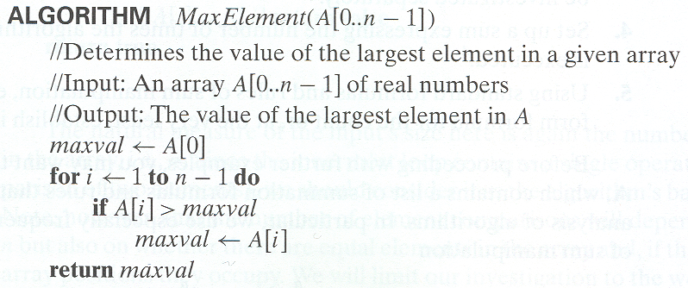
Example 1: Maximum element
T(n) = Σ1≤i≤n-1 1 = n-1 = Θ(n) comparisons

Slide 63
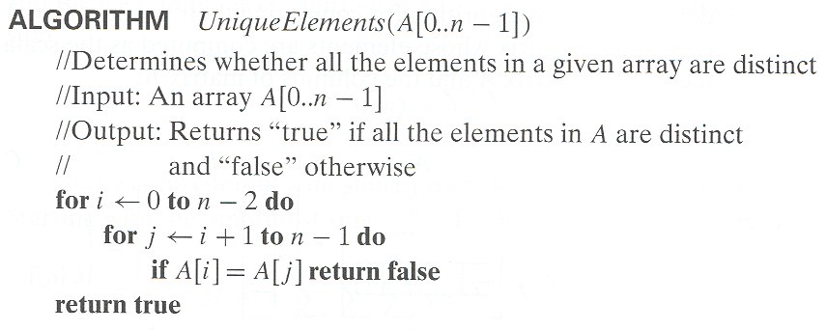
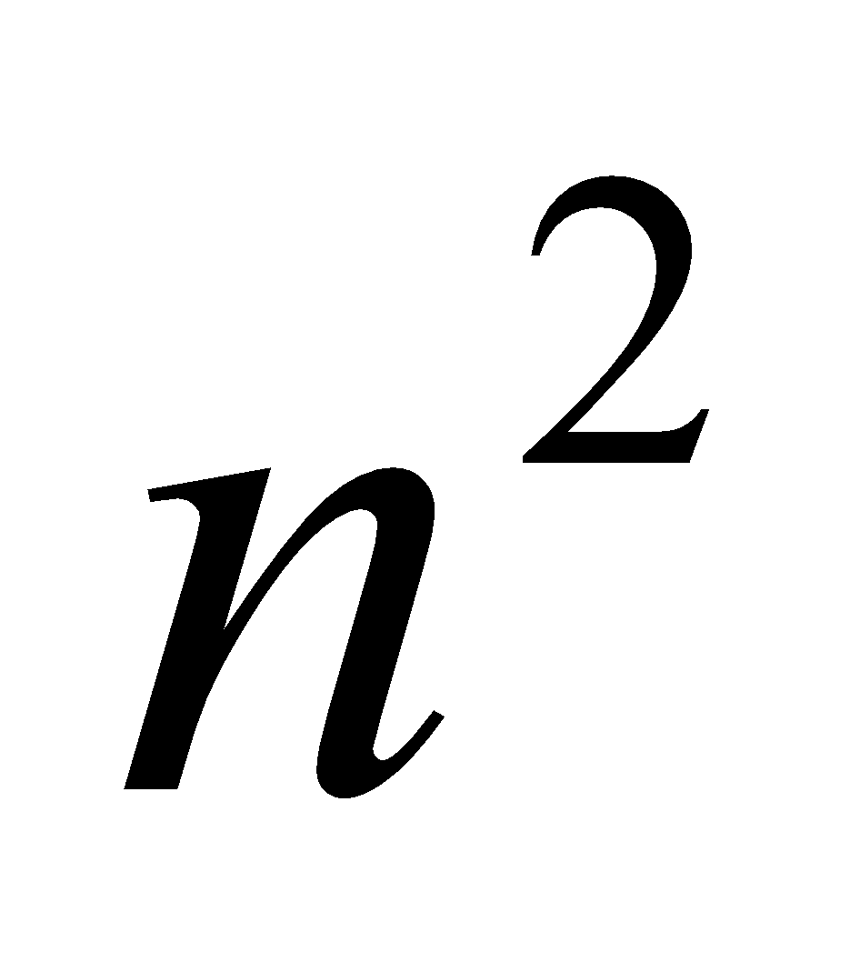
Example 2: Element uniqueness problem
T(n) = Σ0≤i≤n-2 (Σi+1≤j≤n-1 1)
= Σ0≤i≤n-2 n-i-1 = (n-1+1)(n-1)/2
= Θ( ) comparisons

Slide 64
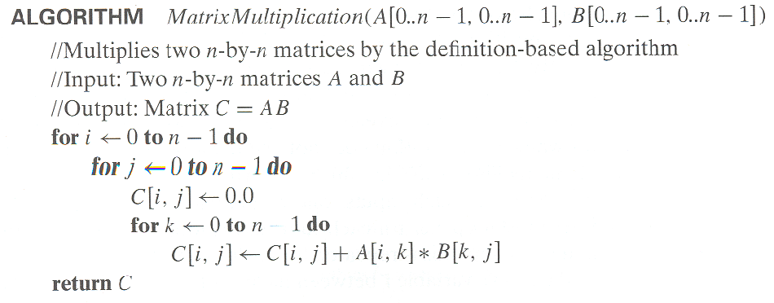
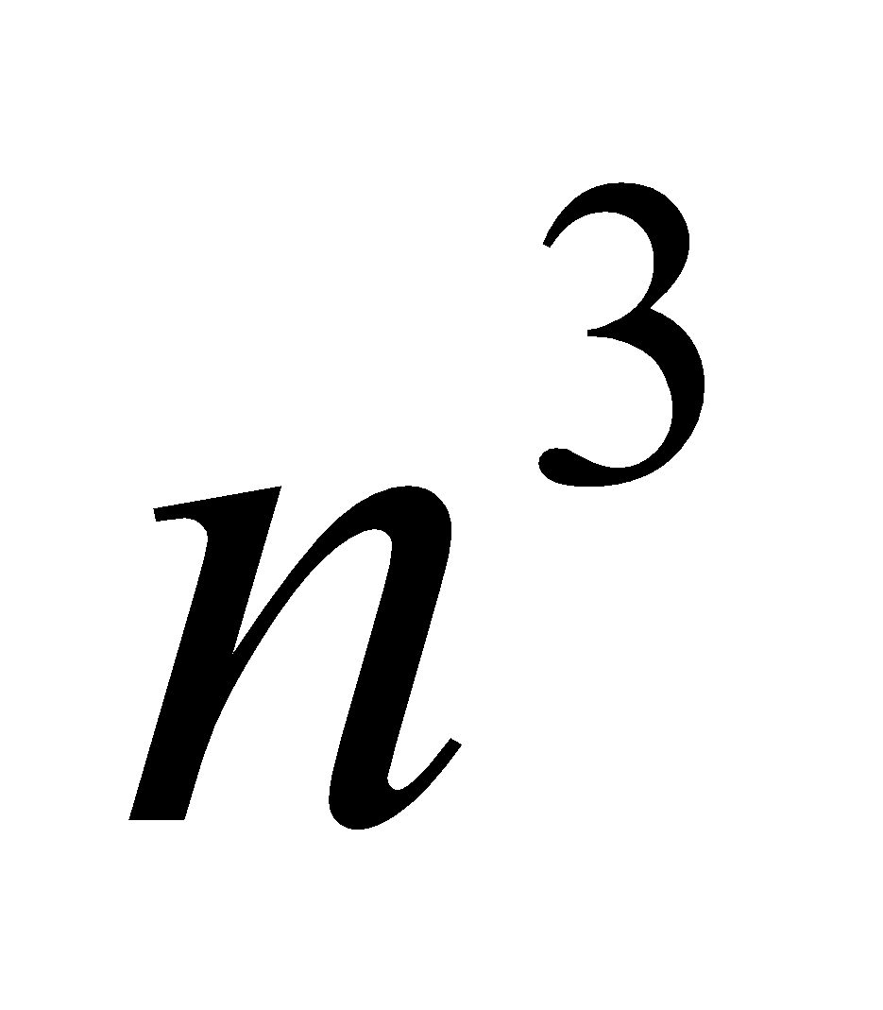
Example 3: Matrix multiplication
T(n) = Σ0≤i≤n-1 Σ0≤i≤n-1 n
= Σ0≤i≤n-1 Θ( )
= Θ( ) multiplications

Slide 65
Example 4: Gaussian elimination
Algorithm GaussianElimination(A[0..n-1,0..n])
//Implements Gaussian elimination on an n-by-(n+1) matrix A
for i ← 0 to n - 2 do for j ← i + 1 to n - 1 do for k ← i to n do
A[j,k] ← A[j,k] - A[i,k] * A[j,i] / A[i,i]
Find the efficiency class and a constant factor improvement.
for i ← 0 to n - 2 do for j ← i + 1 to n - 1 do B ← A[j,i] / A[i,i]
for k ← i to n do
A[j,k] ← A[j,k] – A[i,k] * B

Slide 66
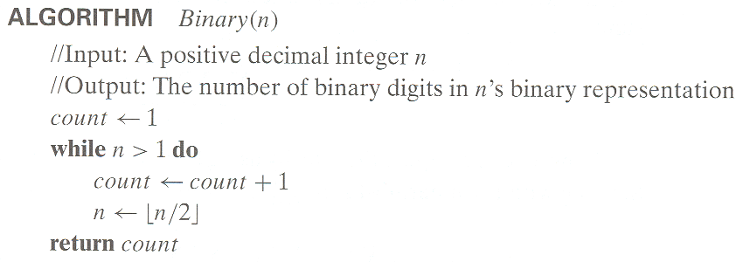
Example 5: Counting binary digits

Slide 67
Plan for Analysis of Recursive Algorithms
Decide on a parameter indicating an input’s size.
Identify the algorithm’s basic operation.
Check whether the number of times the basic op. is executed may vary on different inputs of the same size. (If it may, the worst, average, and best cases must be investigated separately.)
Set up a recurrence relation with an appropriate initial condition expressing the number of times the basic op. is executed.
Solve the recurrence (or, at the very least, establish its solution’s order of growth) by backward substitutions or another method.

Slide 68
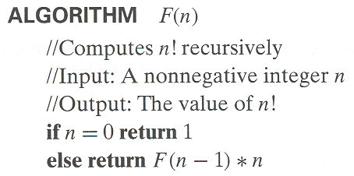
Example 1: Recursive evaluation of n!
Definition: n ! = 1 * 2 * … *(n-1) * n for n ≥ 1 and 0! = 1
Recursive definition of n!: F(n) = F(n-1) * n for n ≥ 1 and
F(0) = 1
Size:
Basic operation:
Recurrence relation:
n
multiplication
M(n) = M(n-1) + 1
M(0) = 0
Notes:
Note the difference between the two recurrences. Students often confuse these!
F(n) = F(n-1) n
F(0) = 1
for the values of n!
------------
M(n) =M(n-1) + 1
M(0) = 0
for the number of multiplications made by this algorithm

Slide 69
Solving the recurrence for M(n)
M(n) = M(n-1) + 1, M(0) = 0
M(n) = M(n-1) + 1
= (M(n-2) + 1) + 1 = M(n-2) + 2
= (M(n-3) + 1) + 2 = M(n-3) + 3
…
= M(n-i) + i
= M(0) + n
= n
The method is called backward substitution.

Slide 70
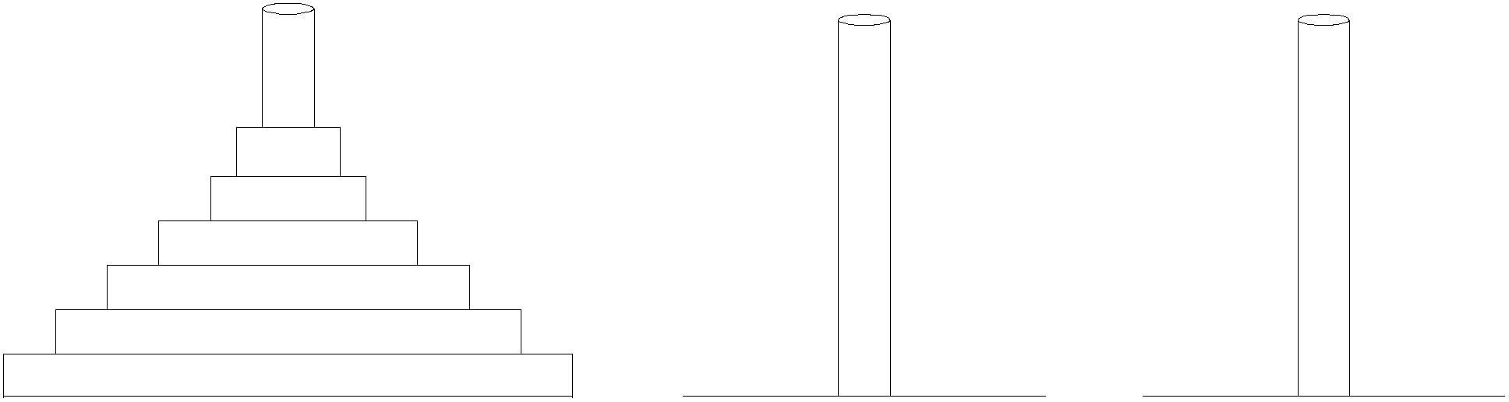
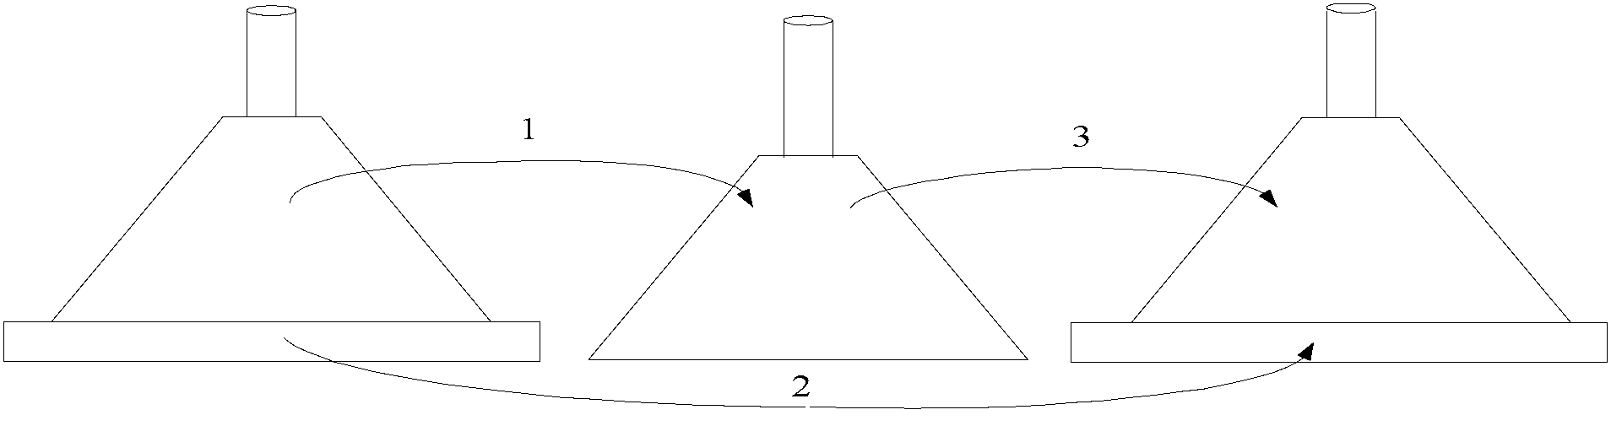
Example 2: The Tower of Hanoi Puzzle
Recurrence for number of moves:
M(n) = 2M(n-1) + 1

Slide 71
Solving recurrence for number of moves
M(n) = 2M(n-1) + 1, M(1) = 1
M(n) = 2M(n-1) + 1
= 2(2M(n-2) + 1) + 1 = 2^2*M(n-2) + 2^1 + 2^0
= 2^2*(2M(n-3) + 1) + 2^1 + 2^0
= 2^3*M(n-3) + 2^2 + 2^1 + 2^0
= …
= 2^(n-1)*M(1) + 2^(n-2) + … + 2^1 + 2^0
= 2^(n-1) + 2^(n-2) + … + 2^1 + 2^0
= 2^n - 1

Slide 72
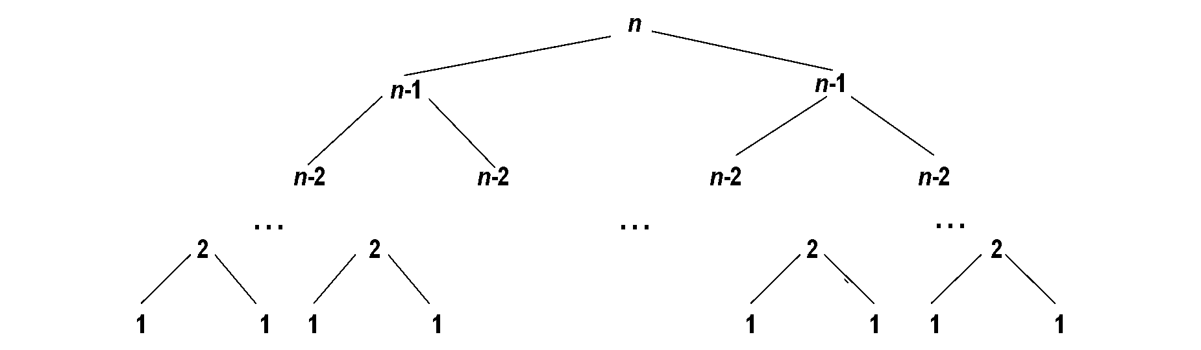
Tree of calls for the Tower of Hanoi Puzzle

Slide 73
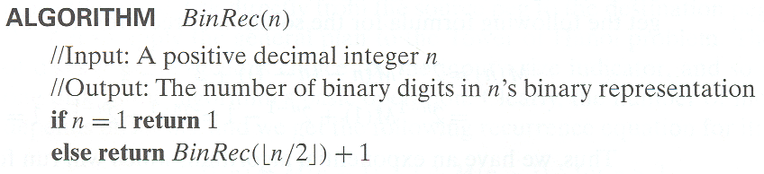
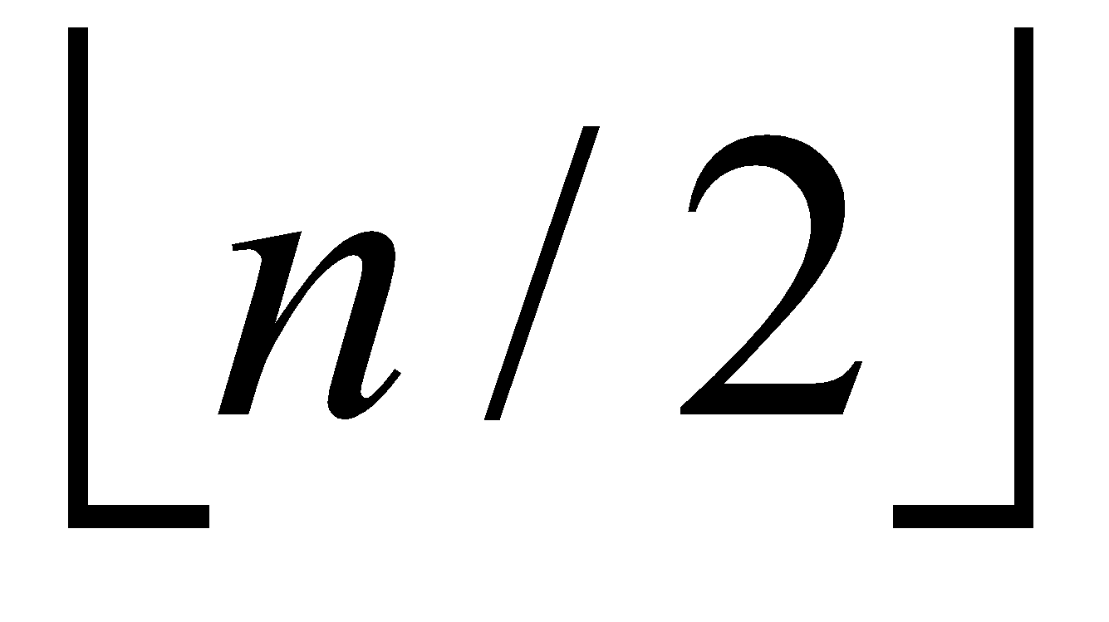
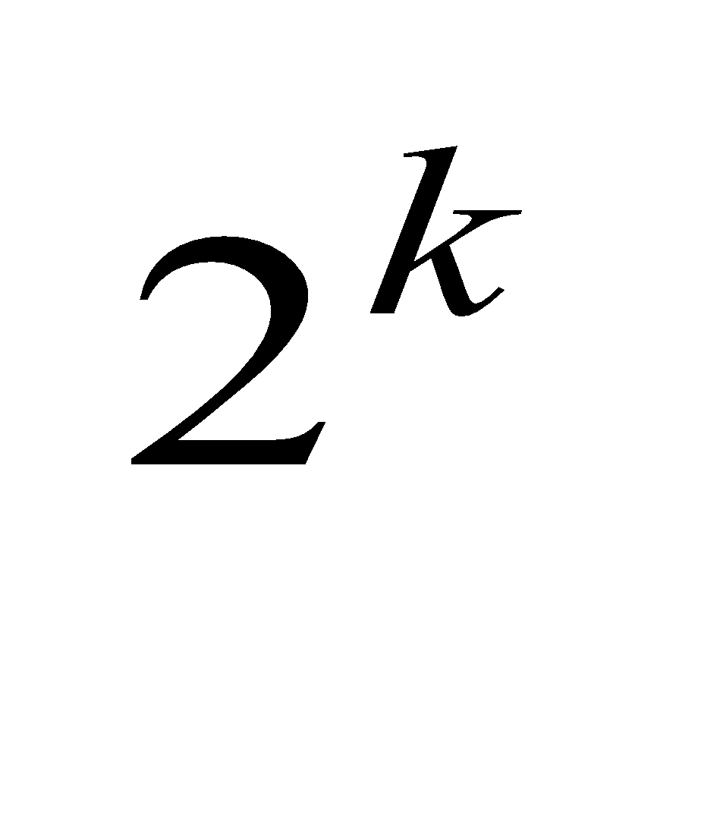
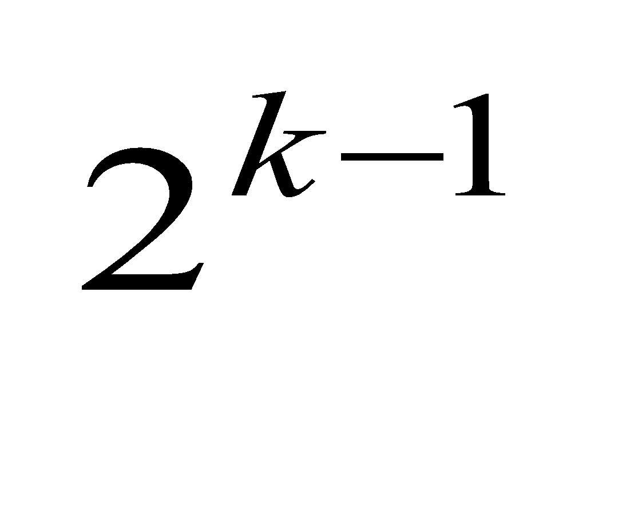
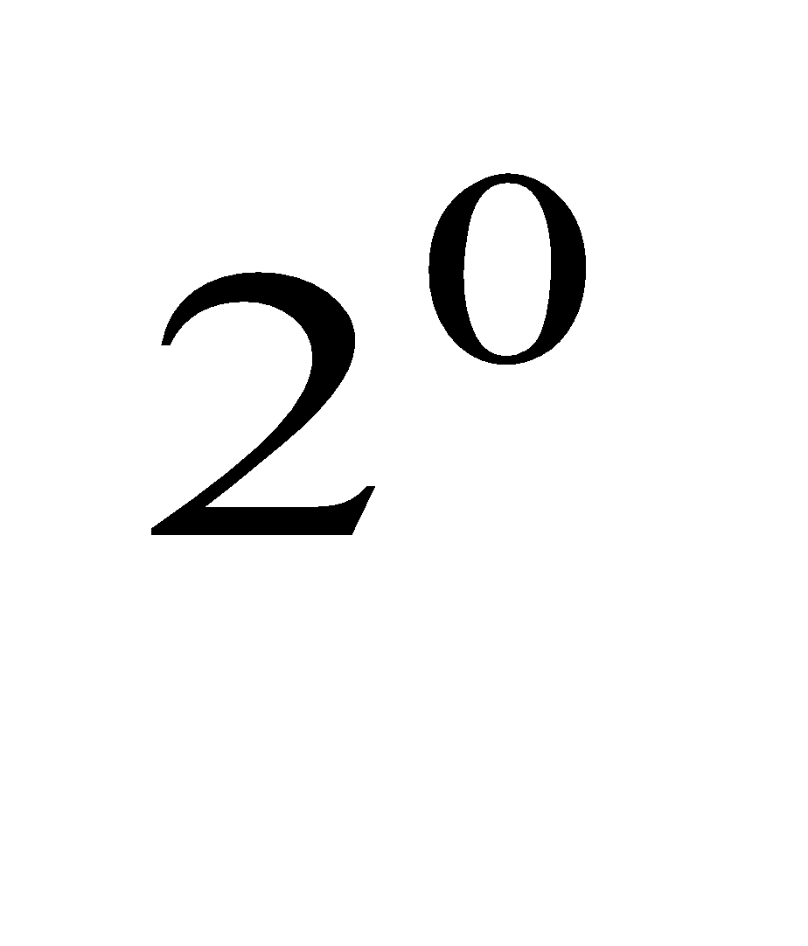
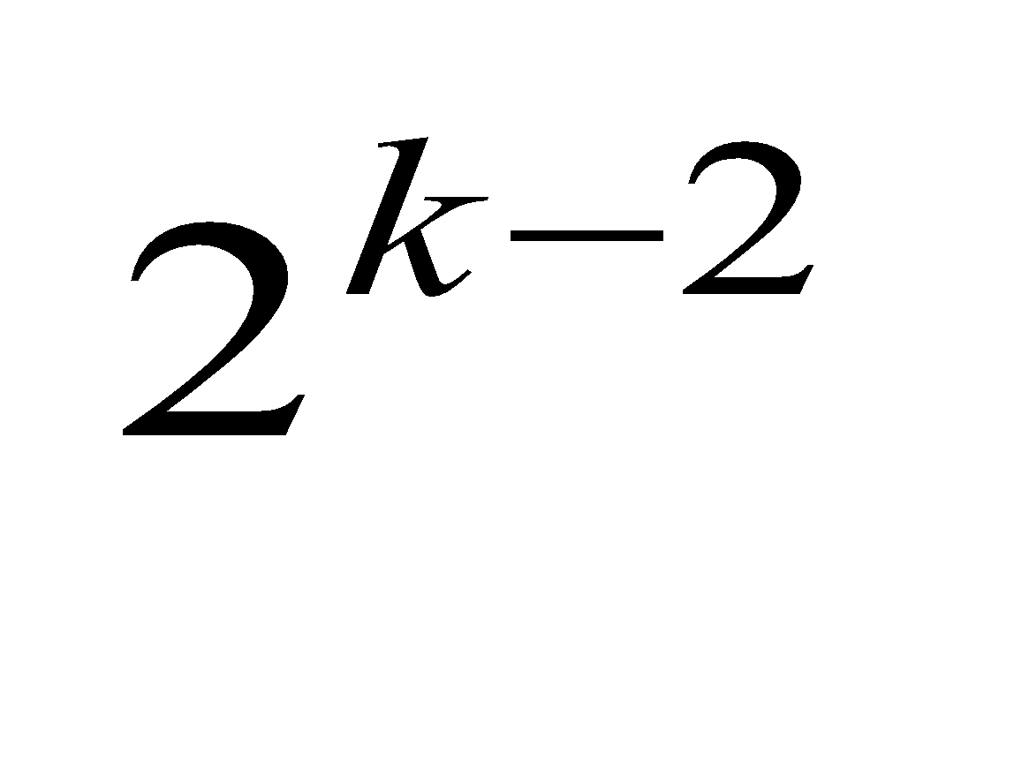
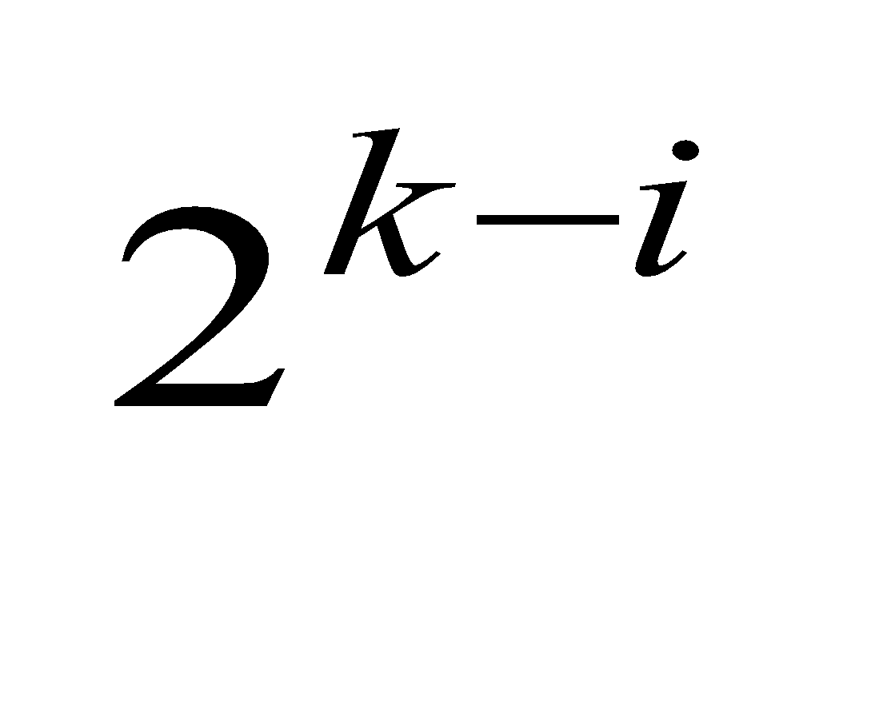
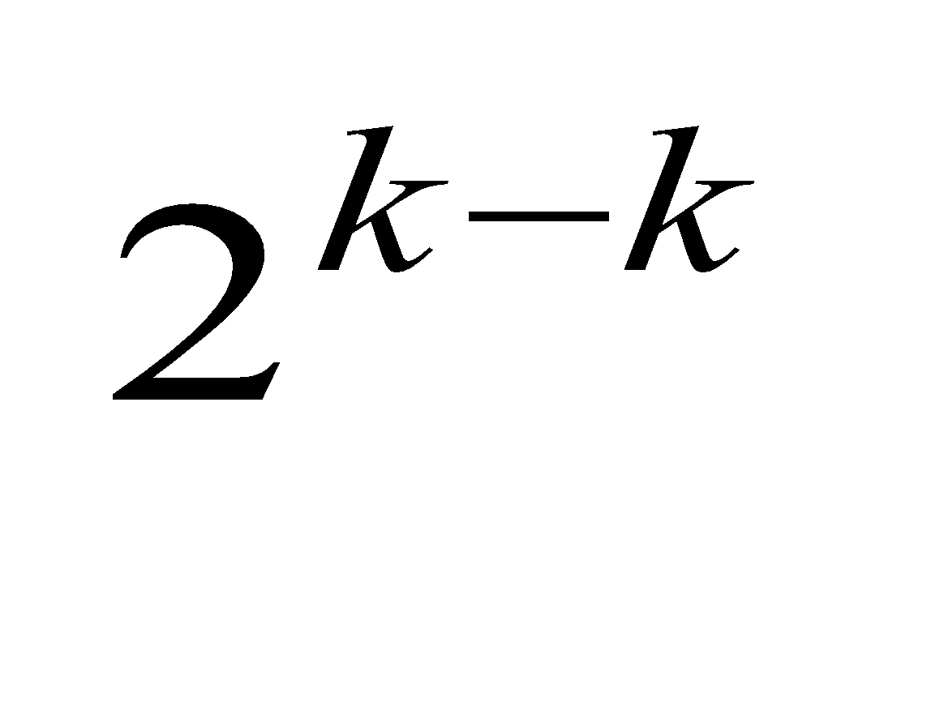
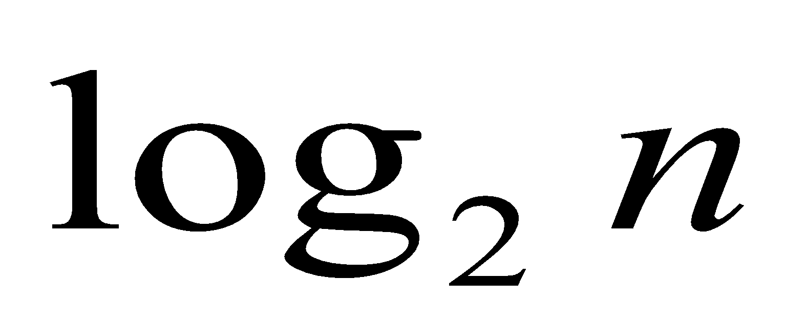
Example 3: Counting #bits
A(n) = A( ) + 1, A(1) = 0
A( ) = A( ) + 1, A( ) = 1 (using the Smoothness Rule)
= (A( ) + 1) + 1 = A( ) + 2
= A( ) + i
= A( ) + k = k + 0
=

